Slide 1
EASY VISA
Ensemble Learning Techniques, PGP - Data Science and Business Analytics Arsalaan B. Saiyed
Date – 24th June 2022

Slide 2
Contents / Agenda
Executive Summary
Business Problem Overview and Solution Approach
Data Background and Contents
EDA Results
Data Preprocessing
Model Performance Summary
Decision Tree & Random Forest Model
Ada Boost Model
Gradient Boost Model
XG Boost Model
Appendices
Appendix-A: EDA Results
Appendix-B: Model Performance Summary

Slide 3
Executive Summary
From exploratory analysis and relative importance we can conclude the likelihood of a booking cancellation depends primarily on the following parameters:

Slide 4
Executive Summary
Recommendations: Based on the insights from EDA and building classification models to predict the booking cancellation we would like to make the following recommendations:

Slide 5
Executive Summary
Recommendations:

Slide 6
Business Problem Overview and Solution Approach
Problem Overview:
Business communities in the United States are facing high demand for human resources. The Immigration and Nationality Act (INA) of the US permits foreign workers to come to the United States to work on either a temporary or permanent basis. The act also protects US workers against adverse impacts on their wages or working conditions by ensuring US employers' compliance with statutory requirements when they hire foreign workers to fill workforce shortages. The immigration programs are administered by the Office of Foreign Labor Certification (OFLC). The process of reviewing every case is becoming a tedious task as the number of applicants is increasing every year.
The objective is to build a Machine Learning based solution that can help in shortlisting the candidates having higher chances of VISA approval. And, to analyze the data provided and, with classification model:
Facilitate the process of visa approvals.
Recommend a suitable profile for the applicants for whom the visa should be certified or denied based on the drivers that significantly influence the case status.
Solution Approach:
Data Overview & EDA
Data pre-processing
Classification Model Building – Decision Trees & Random Forest Tree
Ensemble Techniques
Model Comparisons
Executive Summary - Actionable insights and summary

Slide 7
Data Background and Contents
Observations:
Data was formatted appropriately.
There is no missing or duplicated data
Observations | Variables
25,480 | 12
Table 1: Shape of the data
Variable | Description
case_id | ID of each visa application
continent | Information of continent the employee
education_of_employee | Information of education of the employee
has_job_experience | Does the employee has any job experience? Y= Yes; N = No
requires_job_training | Does the employee require any job training? Y = Yes; N = No
no_of_employees | Number of employees in the employer's company
yr_of_estab | Year in which the employer's company was established
region_of_employment | Information of foreign worker's intended region of employment in the US.
prevailing_wage | Average wage paid to similarly employed workers in a specific occupation in the area of intended employment. The purpose of the prevailing wage is to ensure that the foreign worker is not underpaid compared to other workers offering the same or similar service in the same area of employment.
unit_of_wage | Unit of prevailing wage. Values include Hourly, Weekly, Monthly, and Yearly.
full_time_position | Is the position of work full-time? Y = Full Time Position; N = Part Time Position
case_status | Flag indicating if the Visa was certified or denied
Table 2: Details

Slide 8
EDA Results – Univariate Analysis
Upon conducting a univariate analysis of the raw data and computing the statistical summary we observed the following:
Median Employee count of comes out to be 2,109 and a high mean of 5,667. This because some MNCs have hundreds of thousands of employees such as case ID:EZYV21340 with an employee count of 602,069.
Mean prevailing wage was found to be 74,456 and median was 70,308. Note that prevailing wage is influenced by the unit category and we do not have enough info to convert them all into one category so we go ahead as is.
We can see that most of the companies in the our data were established after the 1950s and the beginning of the 21st century due to the industrial and digital revolution.
Most of the applicants are from Asia(66.2%) and Europe(14.7%) and they make up approximately of 80% of the applicants. We also have North America with 12.9%, South America with 3.3%, Africa with 2.1% and the least from Oceania 0.8%.
Applicants with bachelor’s and masters degree make up 40.2% and 37.8% of all applicants respectively. Doctorate degree holders account for 8.6% and applicants possessing only a high school degree make up about 13.4% of all applicants.
Around 60% of all applicants have prior work experience.
Around 90% of all applicants have don’t require job training.
Majority of the applicants(28.2%) are applying to jobs in Northeast America and only 1.5% to Island.
90.1% of applicants are offered an annual salary package
90% of the applications are for a full-time position
66.8% of all applications have been certified
Note: The mean, min, max etc. for all columns are given in the statistical summary in a table in Appendix-A
Link to Appendix slide on data background check

Slide 9
EDA Results – Bivariate Analysis
Upon conducting a bivariate analysis of the raw data we observed the following:
From the heatmap we can see that there is no strong correlation between numerical features.
The most recorded applications were to South of USA from people with bachelor’s degree.
All regions have 80% or higher percentage of applicants that do not require job training.
Bachelor’s and masters degree applicants have an acceptance rate of 62.21% and 78.63% respectively.
The highest acceptance rate was among the applicants with a doctorate – 87.23% of all applicants were certified but overall contributed only 11.25% of all certified applicants.
The lowest acceptance rate was among applicants with only a high school degree – 34.04% of all applicants were certified and overall contributed only 6.84% of all certified applicants.
Regions with highest acceptance rates are Midwest(75.53%), Island(70.93%) and South(70.02%) we can also see that Midwest and Island regions offer a the highest prevailing wage among all regions.
The continent with the highest acceptance rate is Europe(79.23%) and the continent with lowest acceptance rate is South America(57.86%).
From the 66.8% of certified applicants most certified applicants, 43.22% of them belonged to Asia and 11.61% belonged to Europe, this coincides with the fact that Asia and Europe have the most number of applicants between them.
75% of people with job experience were certified and they make up 64.7% of all certified applicants. 43.87% of people with no job experience were denied and they make up 55% of all denied applicants.
The median wage for certified applicants was approximately 72,500 dollars and for denied applicants it was approximately 65,500 dollars.
Approximately 70% of all applicants with yearly unit of wage were certified. Only 35% of all hourly applicants were certified.
Link to Appendix slide on data background check

Slide 10
Data Preprocessing
Duplicate value check
Missing value treatment
Outlier check (treatment if needed)
Feature engineering
Data preparation for modeling
Note: You can use more than one slide if needed

Slide 11
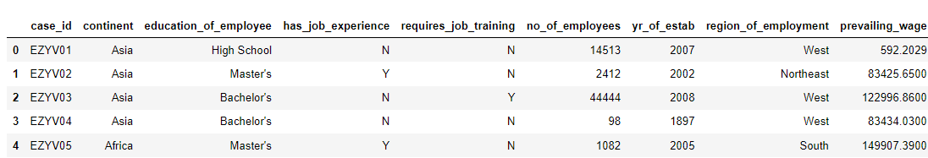
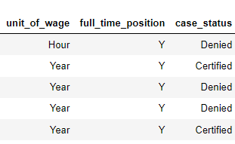
Data Preprocessing
Let’s take a quick look at a small sample of our data. This will help us get some idea of the attributes of the data and also help us understand the degree of cleaning needed before we can build a model.
Random sample of the data (5 rows, 12 columns):

Slide 12
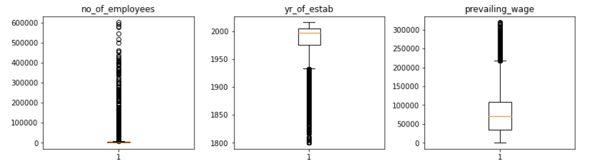
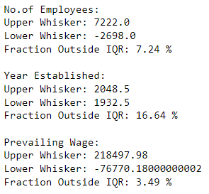
Data Preprocessing
Duplicate Value Check: No duplicate entries were found in the given data
Missing Value Treatment:
Our data has no missing value so no treatment was required.
Outlier Check:
All the other outliers are correct data so we don’t treat them.
As mentioned prevailing wage is not treated because we don’t have enough data like the number of hours worked in a year for hourly paid workers and how many weeks worked in a year for weekly paid workers and how many months worked in a year for monthly paid workers.
Feature Engineering:
There was no need for feature engineering.

Slide 13
Model Performance Summary
Overview of ML model and its parameters
Summary of most important factors used by decision tree and random forest for classification (prediction)
Summary of most important factors used by ensemble technique model for classification (prediction)
Summary of key performance metrics for training and test data in tabular format for comparison of all decision tree and ensemble technique models
Link to Appendix slide on model assumptions

Slide 14
Model Performance Summary
Overview of ML model:
Our objective was to provide Easy Visa insights as to what are the key indicators that influence whether or not an application will be certified or denied, based on which we must recommend a suitable profile for the applicants for whom the visa should be certified or denied based on the drivers that significantly influence the case status
ML model parameters:
Model Selection & Fitting: We build two models for classification and compare the results.
Decision & Random Forest Tree: We will build models using the DecisionTreeClassifier function & RandomForestClassifier
Ensemble Techniques: We will run Bagging & Boosting Models (Ada Boost, Gradient Boost, XG Boost) and also stacking
Model Evaluation Criterion: Model can make wrong predictions as:
Model predicts that the visa application will get certified but in reality, the visa application should get denied.
Model predicts that the visa application will not get certified but in reality, the visa application should get certified.
Which case is more important? Both the cases are important as:
If we predict that an application will be certified but should be denied our model is not correctly filtering the applicants which was the initial aim and still not making the visa review process easier
If we predict that an application will be denied but should be certified we are causing someone an opportunity which is unfair and not a good model
How to reduce the losses? Easy Visa would want F1 Score to be maximized, greater the F1 score higher are the chances of minimizing False Negatives and False Positives.

Slide 15
Model Performance Summary
Summary of most important factors used by the DECISION TREE model for prediction:
Pre-processed data was split into training and testing data with a 70:30 ratio.
Using DecisionTreeClassifier library we fit a decision tree model to the training data set. F1 was found to be 0.99117 for our first model. Our model was overfitting so we resolved this.
Using GridSearchCV we apply pre-pruning before building the decision tree. Using the grid search parameters we get model with a F1 score of 0.77326.
Then using the cost complexity method we calculate various alphas and their impurities. Using different alphas we plot F1 score against the alpha values for training and testing set and determine the most optimal alpha for the highest F1 scores for training and testing data set.
Although the decision tree might look complex and hard to visualize, we leave it as is because this is the most optimal machine learning model.
We then compare all the models and select the best performing one. (Follow hyperlinks for comments on different models)

Slide 16
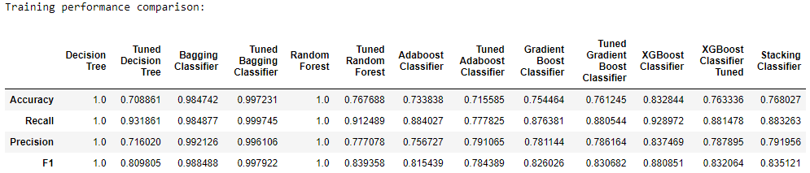
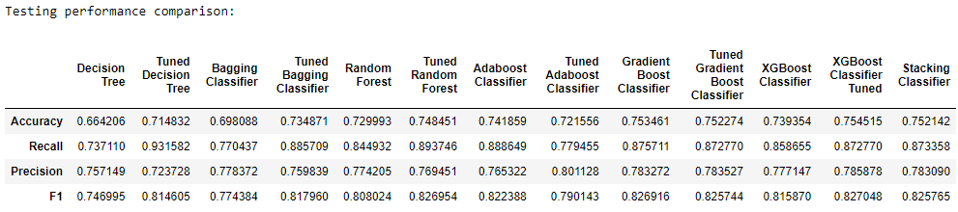
Model Performance Summary
Summary of key performance metrics for training and test data in tabular format for comparison of decision tree model:
Conclusion:
Post-pruning model has a higher F1 and accuracy score for both training and testing data as compared to the pre-pruning model.
The post pruning model seems to be more reliable as the performance for the training and testing data are relatively similar.
The objective was minimize false positives and false negatives therefore, we will pick the model with the highest F1 score which is the post pruning model.

Slide 17
APPENDIX A – EDA Results (Univariate Analysis)

Slide 18
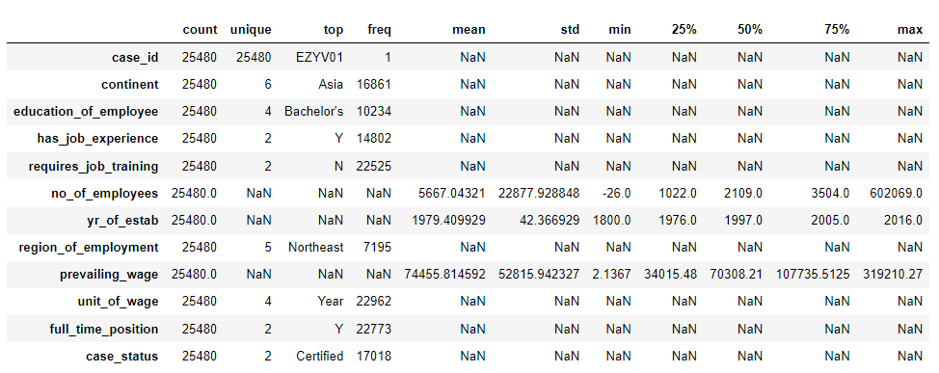
APPENDIX A: Statistical Summary

Slide 19
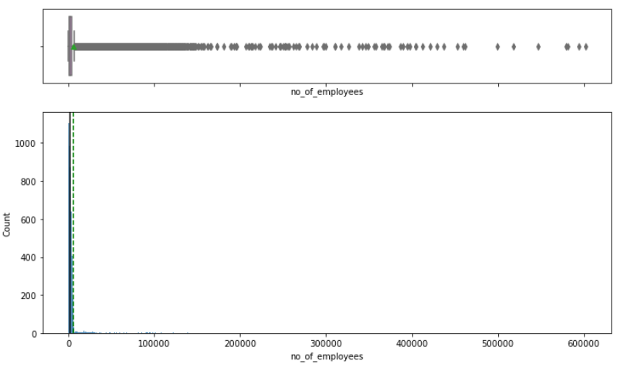
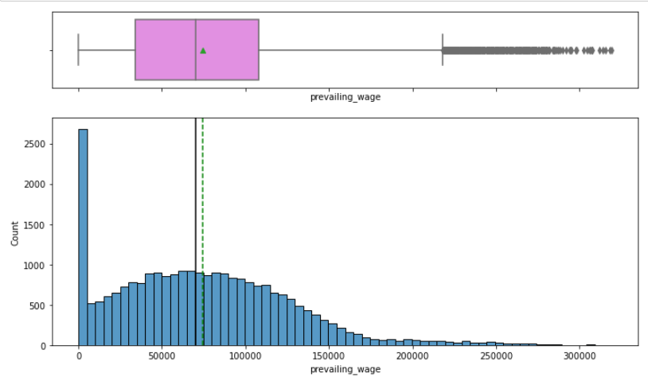
APPENDIX A: Univariate Analysis
Observation:
The data is right-skewed. This is due to companies with large workforces like MNCs
Mean: 5,667
Median: 2,109
Max: 602,069
Observation:
The data is right-skewed. This is due to high salaries offered by some companies or posts with high pay.
Mean: 74,455.8
Median: 70308.21
Max: 319,210.27

Slide 20
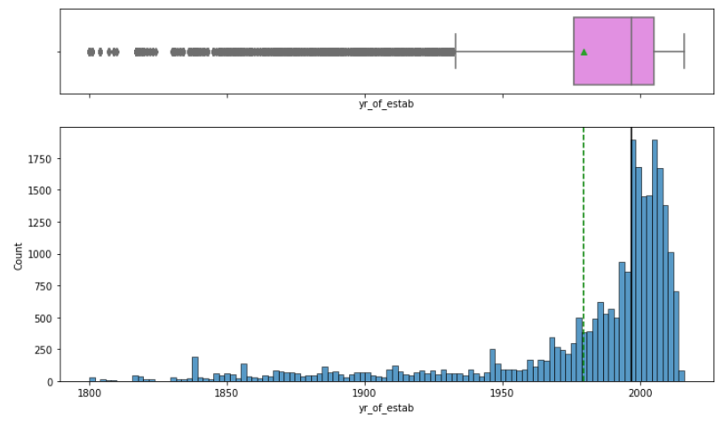
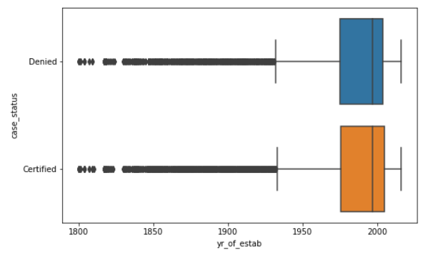
APPENDIX A: Univariate Analysis
Observation:
The data is left-skewed. This is due to a large spike in jobs and population after the 1950s due to the industrial and digital revolution
Min: 1800
Mean: 1980
Median: 1997
Max: 2016

Slide 21
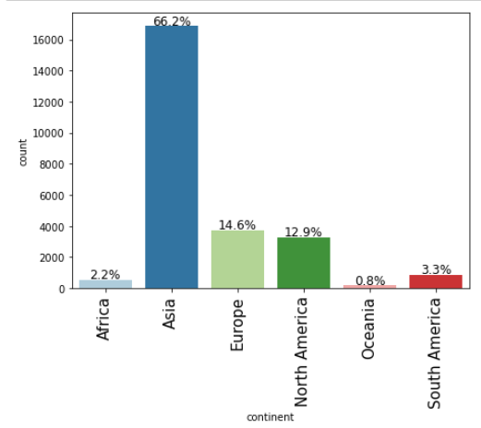
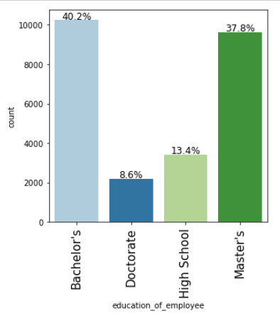
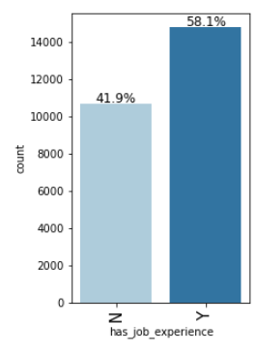
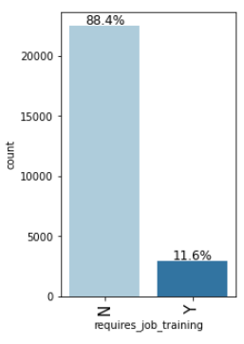
APPENDIX A: Univariate Analysis
Observation:
Majority of the applicants are from Asia and Europe and they make up approximately of 80% of the applicants.
Observation:
Only 13.4% of the applicants have only a high school degree, the rest have a bachelor’s, masters or a doctorate.
Observation:
Around 60% of all applicants have prior work experience.
Observation:
Around 90% of all applicants have don’t require job training

Slide 22
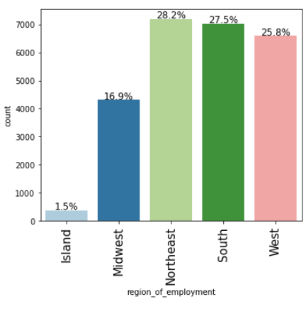
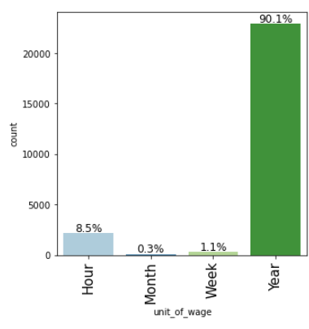
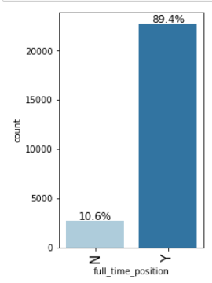
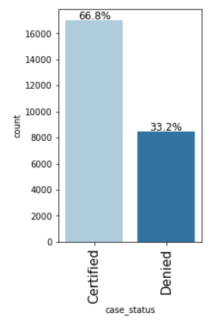
APPENDIX A: Univariate Analysis
Observation:
Majority of the applicants are applying to jobs in Northeast America and only 1.5% to Island.
Observation:
90.1% of applicants are offered an annual salary package
Observation:
90% of the applications are for a full-time position
Observation:
66.8% of all applications have been certified

Slide 23
APPENDIX A – EDA Results (Bivariate Analysis)

Slide 24
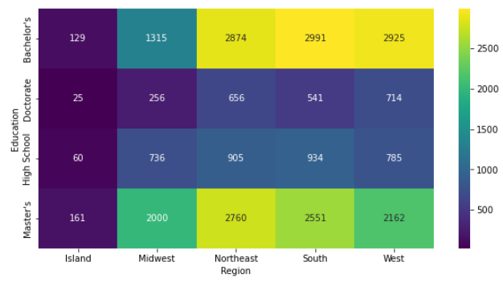
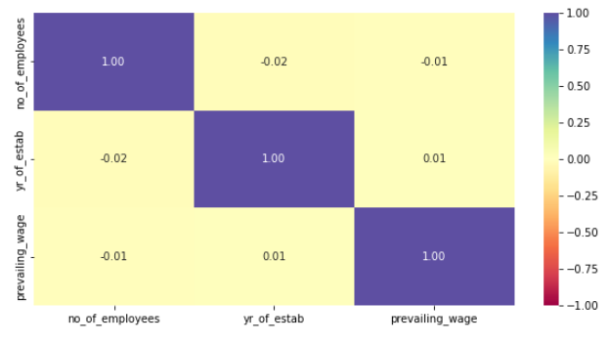
APPENDIX A: Bivariate Analysis
Observation:
No correlation was found between the numerical features
Observation:
The most recorded applications were to South of USA from people with bachelor’s degree.
Most people with a master’s degree applied to the Northeast region of America
People with doctorates preferred the West of USA

Slide 25
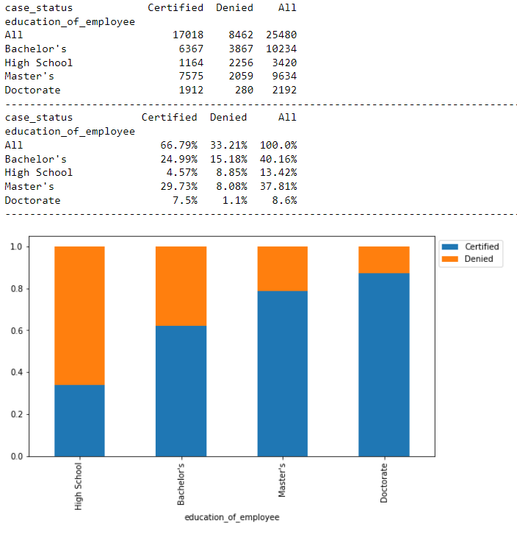
APPENDIX A: Bivariate Analysis
Observation:
The tables and graph on the right show the split of case status by the education of the employee.
Bachelor’s and masters degree applicants have an acceptance rate of 62.21% and 78.63% respectively.
Applicants with bachelor’s and masters degrees contributed to 81.925% of to all 17,018 certified applications the remaining 18.075% are of high school and doctorate degree holders.
The highest acceptance rate was among the applicants with a doctorate – 87.23% of all applicants were certified but overall contributed only 11.25% of all certified applicants.
The lowest acceptance rate was among applicants with only a high school degree – 34.04% of all applicants were certified and overall contributed only 6.84% of all certified applicants.

Slide 26
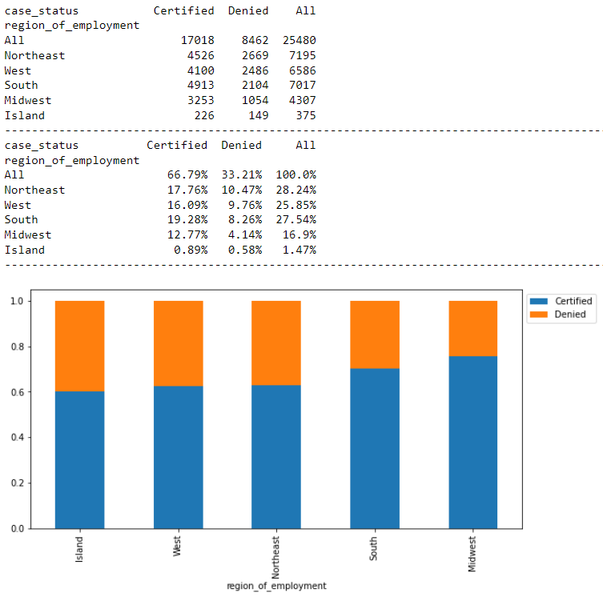
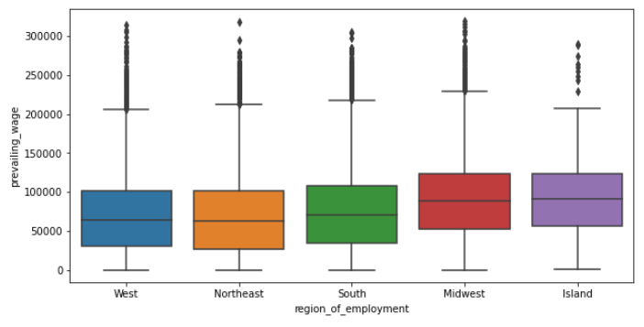
APPENDIX A: Bivariate Analysis
Observation:
South, Northeast and West contribute the most to all the certified applications in the descending order of as mentioned and, it is also worthy to note that these 3 regions have lower prevailing wages in ascending order of as mentioned out of the 5 regions.
Regions with highest acceptance rates are Midwest(75.53%), Island(70.93%) and South(70.02%) we can also see that Midwest and Island regions offer a the highest prevailing wage among all regions.
Northeast and West have an acceptance rate of 62.9% and 62.25% respectively.

Slide 27
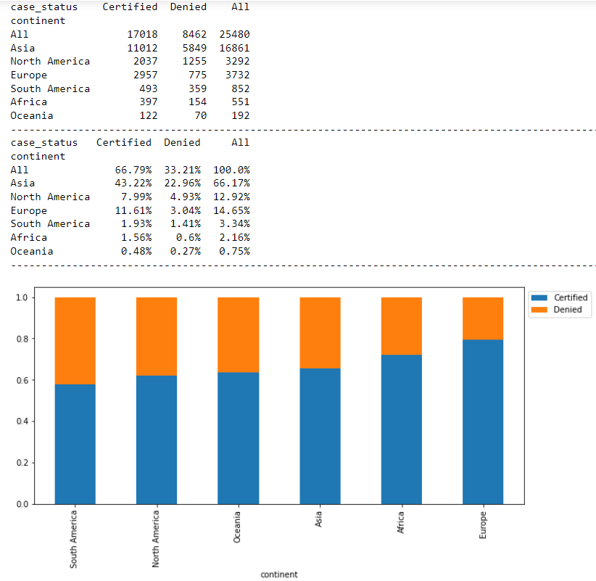
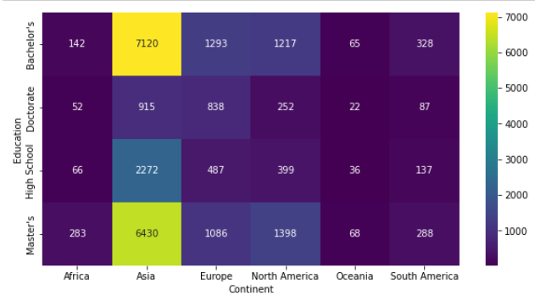
APPENDIX A: Bivariate Analysis
Observation:
The tables and graph on the right show the split of case status by the continent of the applicant.
Most certified applicants, 43.22% of them belong to Asia and 11.61% belong to Europe, this coincides with the fact that Asia and Europe have the most number of applicants between them.
The continent with the highest acceptance rate is Europe(79.23%)
The continent with lowest acceptance rate is South America(57.86%)

Slide 28
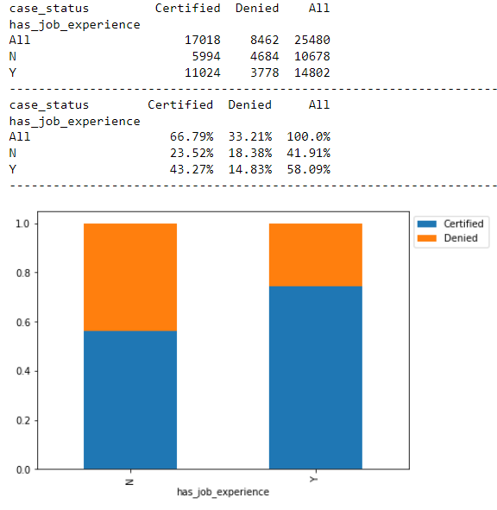
APPENDIX A: Bivariate Analysis
Observation:
The tables and graph on the right show the split of case status by if the applicant has job experience or not.
75% of people with job experience were certified and they make up 64.7% of all certified applicants.
43.87% of people with no job experience were denied and they make up 55% of all denied applicants.

Slide 29
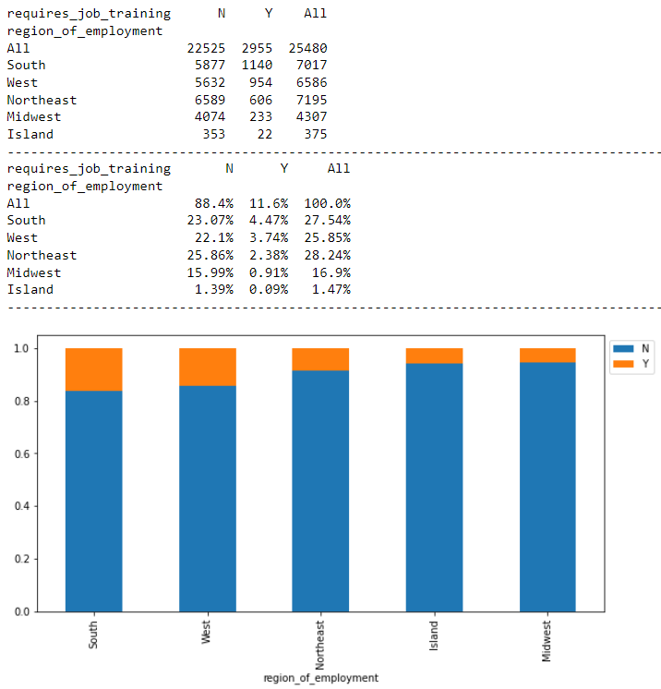
APPENDIX A: Bivariate Analysis
Observation:
The tables and graph on the right show the split of case status by if the applicant has job experience or not.
All regions have 80% or higher number of applicants that do not require job training

Slide 30
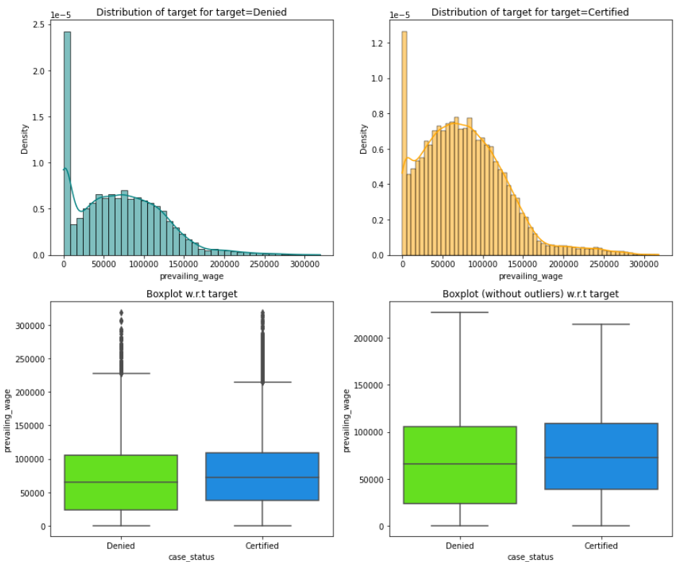
APPENDIX A: Bivariate Analysis
Observation:
Prevailing wage distribution for denied and certified applicants is similar but density of certified application distribution is higher in the same regions because more applications were certified than denied.
The box plots indicate that the applicants that were certified had a higher prevailing wage. The median wage for certified applicants was approximately 72,500 dollars and for denied applicants it was approximately 65,500 dollars.

Slide 31
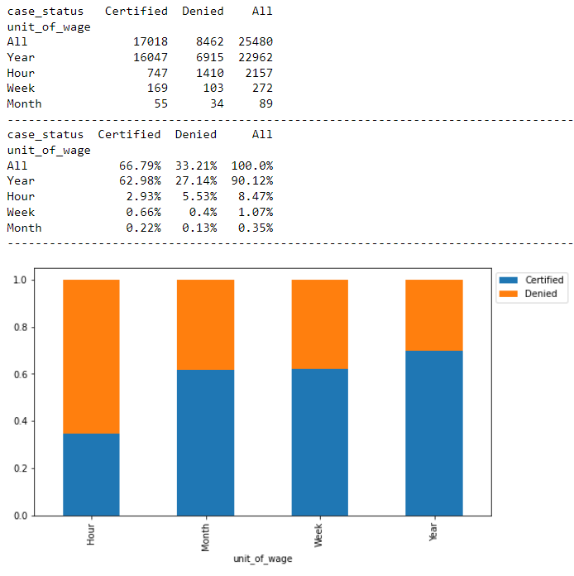
APPENDIX A: Bivariate Analysis
Observation:
Approximately 70% of all applicants with yearly unit of wage were certified.
Only 35% of all hourly applicants were certified.
Weekly and monthly paid applicants had an approximate of 62% certification rate.

Slide 32
APPENDIX B – Model Performance Summary

Slide 33
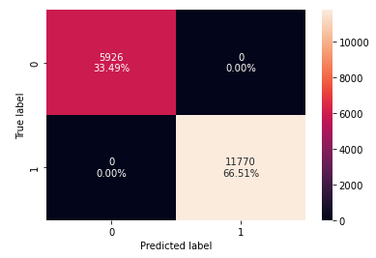
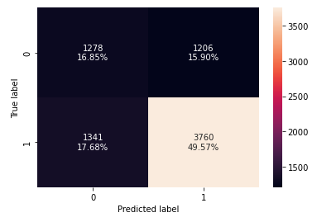
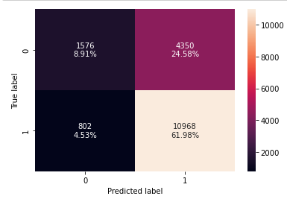
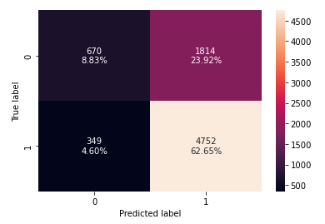




Decision Tree Classification Model
Decision Tree Model
Tuned Decision Tree Model

Slide 34
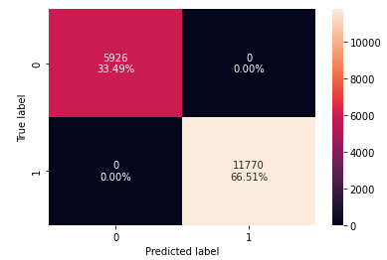
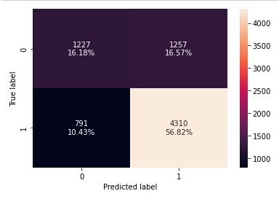
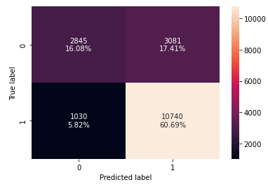
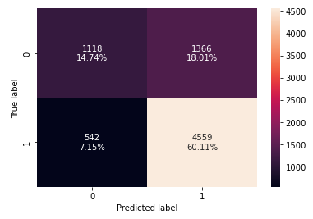




Random Forest Classification Model
Random Forest Model
Tuned Random Forest Model

Slide 35
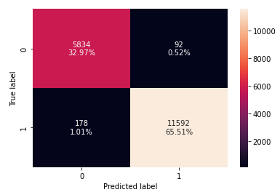
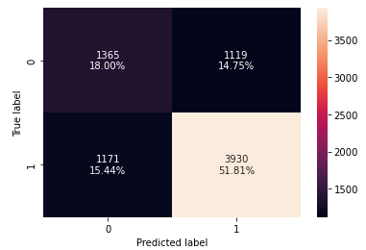
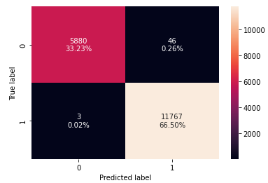
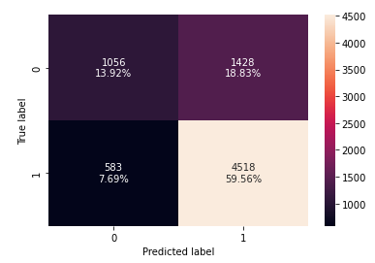




Ensemble Techniques: Bagging Classifier Model
Bagging Model
Tuned Bagging Model

Slide 36
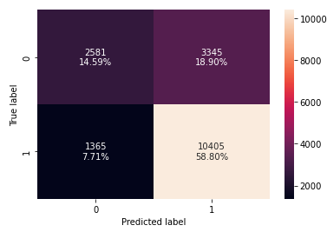

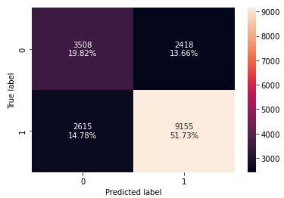
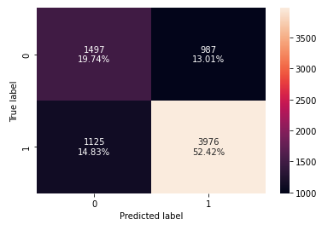




Ensemble Techniques: Ada Boost Classifier Model
Ada Boost Model
Tuned Ada Boost Model

Slide 37
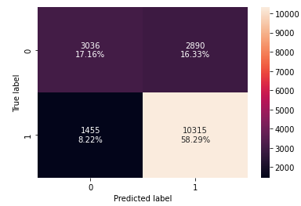

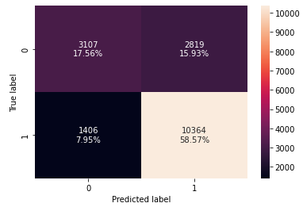
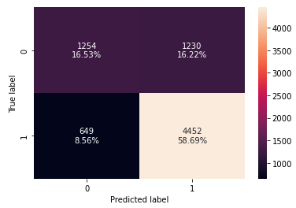




Ensemble Techniques: Gradient Boost Classifier Model
Gradient Model
Tuned Gradient Model

Slide 38
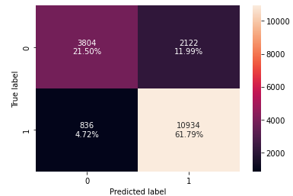
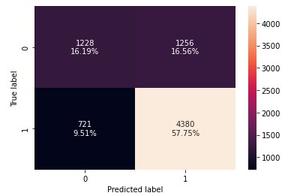






Ensemble Techniques: XG Boost Classifier Model
XG Model
Tuned XG Model

Slide 39





Ensemble Techniques: Stacking

